Slide 1
Communication in embedded systems
Week 6
FreeRTOS

Slide 2
Real Time Operating Systems

Slide 3
OS levels
Every system needs some kind of “hard coded” software to work
There are big differences in capabilities
We here distinguish 3 types
Firmware (Arduino)
Enables at least to upload and run a program from PC
Real Time Operating System (RTOS; FreeRTOS on Nucleo)
Enables threads
Gives real time guarantees
General Purpose Operating System (GPOS; Windows, Linux, MacOS)
Provides extensive services to users and applications

Slide 4
Arduino
Arduino UNO has two microcontrollers, that both have their own firmware
ATMEGA328
After reset (power up, button, or program upload)
if the PC is sending a new program, it is stored into the memory and executed
If the PC is not sending a new program, it starts the one already in memory
ATMEGA8U2
In between USB port and serial port of the ATMEGA328
Contains firmware that makes the Arduino appear as a serial USB device
Both can be reprogrammed

Slide 5
Real Time Operating Systems
RTOS is mainly for convenience; everything can also be done in your own code
What gets easier with an RTOS:
Using timers and interrupts can largely be avoided
Multiple tasks (threads) can easily be run at the same time
Tasks can be synchronized
Wait for each other
Signaling each other
Sharing data between each other
Real time guarantees can be given

Slide 6
How does RTOS differ from GPOS?
RTOS has much smaller memory footprint
Runs on embedded systems rather than PC’s
Less and simpler drivers, security precautions, build-in functionality, etc
Often only one process, which can have multiple threads
GPOS usually pre-installed on the HDD or SDD of a PC RTOS is often just a library that is added to the program
On RTOS, high priority threads can run within given time limits
Low priority thread can be pre-empted when higher priority thread has to run
Note: RTOS is not necessarily fast, but it is predictable in timing behavior
There are many RTOS’s available: https://en.wikipedia.org/wiki/Comparison_of_real-time_operating_systems

Slide 7

FreeRTOS
As an RTOS, we choose FreeRTOS
Started in 2003 by Richard Barry in UK
See: http://blog.atollic.com/interview-with-richard-barry-the-founder-of-freertos
Developed by his company “Real Time Engineers Ltd”, now also on AWS
Designed to be small and simple; emphasis is on compactness and speed
Consists of only three C files, written mostly in C, with some assembly functions
Can be thought of as a 'thread library' rather than an 'operating system’
Basic memory management; libraries for TCP/IP stack, IoT, CLI, etc
Provides for multiple threads, mutexes, semaphores, queues, software timers
Threads are referred to as “tasks”

Slide 8
How do Arduino and Nucleo relate?
Arduino
Everything in one task
Single stack
Complicated to handle multiple tasks at once
Timers
Interrupts
Nucleo

Slide 9

FreeRTOS memory footprint
For a very basic configuration (just to get the idea)
RAM < 500 bytes
ROM < 10 KBytes
Note:
FreeRTOS is ideal for small MCU’s!
From https://www.freertos.org/FAQMem.html

Slide 10
CMSIS
Cortex Microcontroller Software Interface Standard
Cortex-M is a 32-bit RISC ARM architecture, licensed by ARM Holding
Developed by consortium of silicon and tool vendors along with ARM Holding in 2008
Including ST Microelectronics, manufacturer of the Nucleo boards
Standardizes the way in which developers access Cortex-M core and registers
Provides developers with common interface, no matter what silicon vendor is used
Can be used to access FreeRTOS in a standardized way
See: https://www.arm.com/why-arm/technologies/cmsis

Slide 11
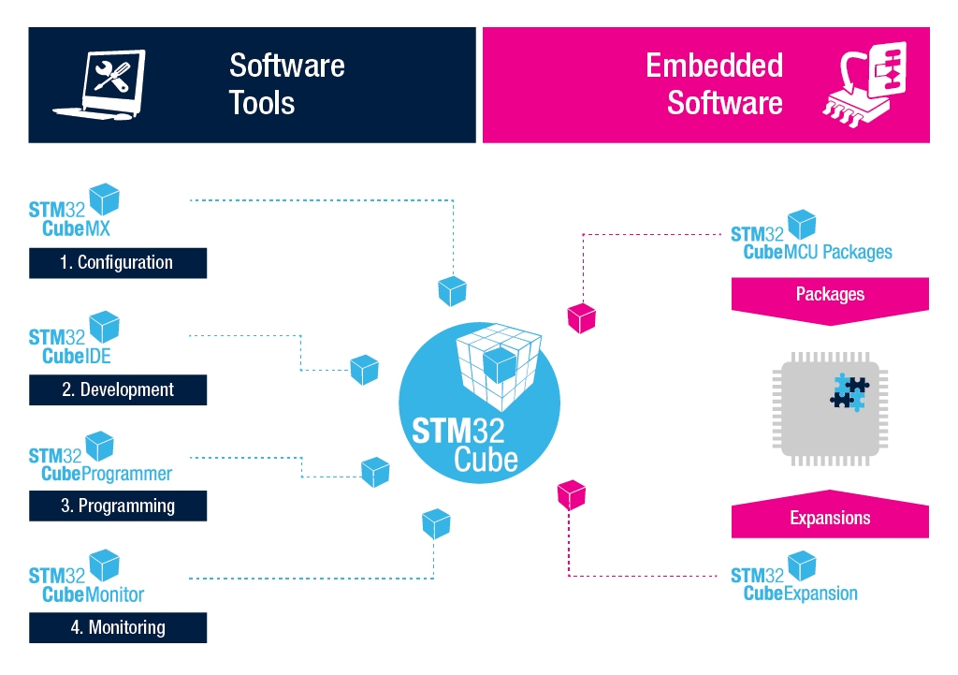

Slide 12
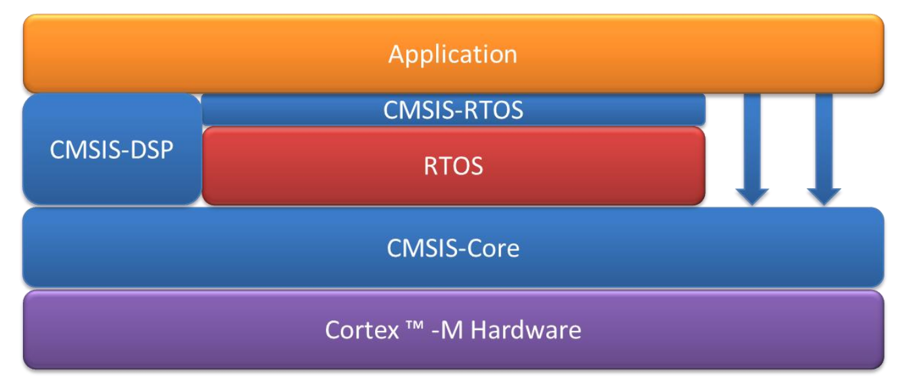
CMSIS overview
CMSIS-RTOS provides access to the actual RTOS
This part is exchangeable
We choose FreeRTOS here

Slide 13
Why do we use CMSIS, and not FreeRTOS directly?
On Nucleo, CMSIS is the preferred way of working
Tightly integrated with STM32CubeMX
Standard interface to multiple RTOS’s
Makes code more portable
Downside:
Not optimally documented
Since CMSIS is not FreeRTOS specific, for some details, FreeRTOS documentation still needed

Slide 14
The Cortex Microcontroller Software Interface Standard (CMSIS) is a big library containing at least:
CMSIS-CORE: bare-metal run-time system for Cortex-M devices. Includes startup code, interface functions to the processor core, and definitions for peripheral access.
CMSIS-RTOS: standardize interface to real-time operating systems (RTOS) including a reference implementation based on RTX.
CMSIS-DSP: software library with common digital signal processing (DSP) functions; optimized for the various Cortex-M processors.
CMSIS-SVD: system view description (SVD) for device and peripheral awareness during debugging and consistent device header files.
CMSIS-DAP: firmware to interface with the debug access port (DAP) of Cortex devices that is frequently used by evaluation kits.
I guess most of the time when people saying CMSIS, they have CMSIS-CORE on their minds. core_cmx.h is what they are talking about. Those routines about NVIC, SYSTICK etc, like NVIC_EnableIRQ() or SysTick_Config()...
You will see this standard routines in every ARM Cortex Mx chip, not just in ST.
CMSIS-RTOS is a standard INTERFACE to your (preferred) RTOS. By the way, ARM has their own RTOS, called RTX.
I am not very clear why they do this interface, and I am not using it personally. In this case, for example, if you are using FreeRTOS, a xTaskCreate() (a FreeRTOS function) would be wrapped into osThreadCreate() (CMSIS-RTOS interface).
CMSIS-DSP supports a lot of math functions that is quite efficient, at least for me. Take a loot at

Slide 15
CMSIS-RTOS
CMSIS-RTOS covers the following functionality:
Thread Management
Define and create threads
Thread control, e.g. delay, yield and priority management
Timers for callbacks
Mutual Exclusion
Counting Semaphore
Mutex
Inter-task Communication& Synchronization
Signals
Message Queues
Mail queue (mailbox)
Memory Management
Memory pools

Slide 16
Programs, processes, threads concepts

Slide 17
Programs, processes and threads
In general, we have these differences
A program is an executable file (.exe; .elf; …)
A process is what you get when you start a program
One program can be started multiple times → multiple processes can run the same program
Every process is running exactly one program
A thread is a part of a process which actually executes the code
By default, one thread is created automatically (the “main thread”)
More threads can be added as needed
Each thread executes its own part of the code (function/method)

Slide 18

Subtasks inside a process
waiting for user input
calculating cells
printing
spell checking
saving backup

Slide 19
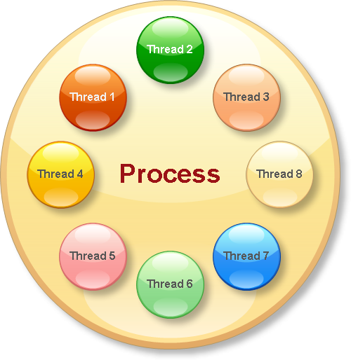
Handling subtasks inside a process
while (...)
{
check user input;
calculate cells;
check spelling;
do backup;
do print;
wait a while;
}

Slide 20
Threads in a process
Thread is a part of a process that executes its own code
Each CPU core can execute one thread at a time
Advantages when using threads:
easier to implement
easier to replace
distributed execution (multi core!)
Disadvantages:
complexity in Operating System
overhead in Operating System

Slide 21

Multithreading is like a multi headed dragon
Each head is like a thread
Each head can ‘think’ and ‘act’ on its own
Each head has its own memory
All heads share the same body
Less heavy than 7 dragons with one head each
This analogy is not perfect:
Threads can be created or killed at wish
Threads can share memory

Slide 22
Thread scheduling

Slide 23
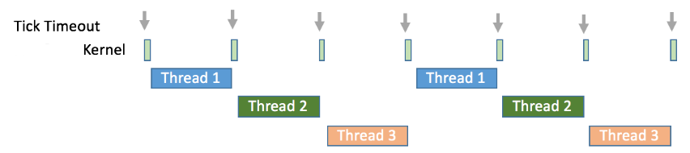
How are threads executed by CPU?
CPU switches between threads
Every thread gets a certain amount of time, and is then interrupted by a timer
This is called pre-emption
Thread then must wait while other threads are executing one by one
Every thread regularly gets a turn
This is called Round Robin (RR) scheduling
Between 2 threads, kernel runs shortly
Pre-emption

Slide 24
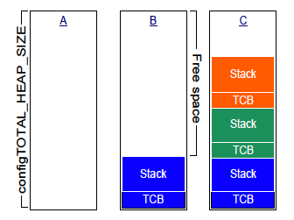
FreeRTOS memory usage
Discussion:
What happens if a task ends?
Note:
Beware of words and bytes!
From https://freertos.org/Documentation/161204_Mastering_the_FreeRTOS_Real_Time_Kernel-A_Hands-On_Tutorial_Guide.pdf
Notes:
When running FreeRTOS on a board like the NUCLEO-F303RE one has to be aware of the memory layout and usage.
The configTOTAL_HEAP_SIZE is the heap on which memory can be allocated dynamically. It is used for allocate memory for the tasks (threads) created, including the stack!
In case many tasks have to be created it might be needed to increase configTOTAL_HEAP_SIZE.
In case a task uses much memory it might be needed to increase its stack_mem attribute in const osThreadAttr_t defaultTask_attributes.
One can use xPortGetFreeHeapSize() to get the free heapsize.
Important note: In FreeRTOSConfig.h the configMINIMAL_STACK_SIZE and configTOTAL_HEAP_SIZE are defined. The configMINIMAL_STACK_SIZE is in words (1 word = 4 bytes) while the configTOTAL_HEAP_SIZE is in bytes.
In this case for each new task 624 bytes are allocated from the heap for the stack (512 bytes) and the Task Control Block (TCB) (112 bytes).

Slide 25
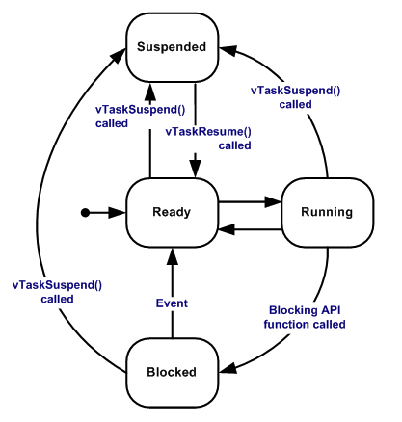
FreeRTOS threads - states
New task is created using osThreadNew
Round Robin preemptive scheduling used
From https://www.freertos.org/RTOS-task-states.html
Notes:
Discuss the different task states as described at https://www.freertos.org/RTOS-task-states.html.

Slide 26
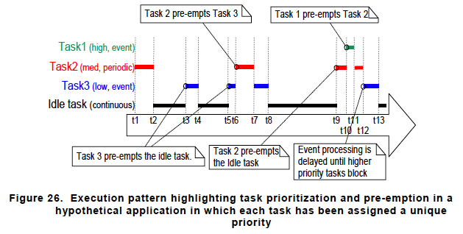
FreeRTOS threads – priority scheduling
Discussion:
What makes FreeRTOS a Real-time OS? Is Linux also a Real-time OS?
From https://freertos.org/Documentation/161204_Mastering_the_FreeRTOS_Real_Time_Kernel-A_Hands-On_Tutorial_Guide.pdf
Notes:
Discuss the picture as described in https://freertos.org/Documentation/161204_Mastering_the_FreeRTOS_Real_Time_Kernel-A_Hands-On_Tutorial_Guide.pdf

Slide 27
Threads and ISR’s

Slide 28
How do threads and ISR’s relate?
The lowest priority interrupt will interrupt the highest priority task
A task can not pre-empt an ISR
Threads will only run when there are no ISRs running
Disable interrupts if a thread should not be interrupted,
Because of this
ISR needs to be as short as possible
Shortest possible reaction on an external event
Thread is usually never ending
Continuous ongoing task

Slide 29
Threads and ISR’s
Suppose, we have an external device that delivers values to the controller
Ways of handling these values:
Not using threads:
generate interrupt for each value
ISR reads and processes the value
Combining threads and ISR:
generate interrupt for each value
ISR reads the value, and wakes up thread to process the value
Not using ISR:
thread checks for new values regularly
when there is a new value, thread reads and processes it
Only if processing can be done very quickly
If processing takes longer, but value must be processed as quickly as possible
If processing takes longer, and there is no need to process immediately

Slide 30
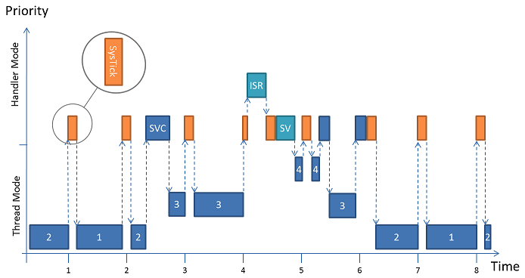
FreeRTOS threads and interrupts
From https://www.keil.com/pack/doc/CMSIS/RTOS2/html/theory_of_operation.html and From https://freertos.org/Documentation/161204_Mastering_the_FreeRTOS_Real_Time_Kernel-A_Hands-On_Tutorial_Guide.pdf
Notes:
Discuss the picture as described in https://www.keil.com/pack/doc/CMSIS/RTOS2/html/theory_of_operation.html:
The scheduler combines priority and round-robin based context switches. The example depicted in the image above contains four threads (1, 2, 3, and 4). Threads 1 and 2 share the same priority, thread 3 has a higher one and thread 4 the highest (osThreadAttr_t::priority). As long as threads 3 and 4 are blocked the scheduler switches between thread 1 and 2 on a time-slice basis (round-robin).
Some CMSIS-RTOS2 functions can be called from interrupt context, like functions handling semaphores, message queues and memory allocation. This is only allowed when the timeout is set to 0. However, some additional settings might have to be done in FreeRTOSConfig.h to make it work. Functions handling mutexes cannot be called from interrupt context.

Slide 31
Threads in FreeRTOS /CMSIS

Slide 32
Specifics about threads in FreeRTOS
Threads are not supposed to end
Undefined behavior when thread reaches end of its function
Like a plane reaching the end of the landing strip: might end well, or might crash
OS will always choose thread with highest priority
Lower priority thread only runs when all higher priority threads are blocked

Slide 33
Specifics about threads in FreeRTOS
Thread priorities are supported
Implements multiple threads by calling thread tick method at regular intervals
Thread tick method switches tasks depending on priority and RR scheduling
Interval is 1/1000 sec to 1/100 sec, via interrupt from hardware timer
Tick-less mode is possible for low power applications

Slide 34
Initializing the kernel in CMSIS2
Before anything else, the kernel must be initialized with osKernelInitialize()
Initializes the RTOS Kernel
Before it is successfully executed, only these functions may be calle:
osKernelGetInfo,
osKernelGetState

Slide 35
Starting the kernel in CMSIS2
The kernel is started with osKernelStart();
Starts the RTOS kernel and begins thread switching
Kernel must be initialized first
Before it is successfully executed, only these functions may be called:
osKernelGetInfo,
osKernelGetState,
object creation functions of the form osXxxNew → to create a thread, use osThreadNew
At least one thread should be created prior to osKernelStart
Will not return in case of success (so runs ‘forever’)

Slide 36
Creating a thread in CMSIS2
A new thread can be created by:
osThreadNew(func, → the function that will be executed by the thread &argument, → the argument for func &attributes → settings for the thread (name, memory, priority, ..) );
Returns pointer to thread identifier
When called before osKernelStart
Thread is added to thread list; will start when osKernelStart is called
When called after osKernelStart (by another thread):
Thread is added to thread list, and starts immediately

Slide 37
Main flow in CMSIS2
#include "cmsis_os.h“ …
osThreadId_t taskHandle;
const osThreadAttr_t task_attributes = { .name = "defaultTask", .priority = (osPriority_t) osPriorityNormal, .stack_size = 128 * 4 };
void StartTask01(void *argument); …
int main(void) osKernelInitialize(); … taskHandle = osThreadNew(StartTask01, &arg, &task_attributes); … osKernelStart(); /* We should never get here as control is now taken by the scheduler */ while(1){}; }
Notes:
Notes
The task function of osThreadNew() needs to be a function with ‘C’ linkage an takes one void* parameter. If you want a C++ class member function to act as the task, you need to wrap it with a wrapper that looks something like: void taskfun(void* parm) { static_cast<classname *>(parm)->memberfun() }

Slide 38
Communication / synchronisation between tasks
Memory pools
Message queues
Semaphores
Mutexes (not from ISR)
Discussion:
What is the purpose of each of these communication / synchronization techniques?
From https://arm-software.github.io/CMSIS_5/RTOS2/html/rtos_api2.html#rtos_api2_functions
Notes:
Note that memory pools and message queues are thread safe.

Slide 39
STM32CubeMX
STM32CubeMX, a configuration tool for any STM32 device. This easy-to-use graphical user interface generates initialization C code for Cortex-M cores and generates the Linux device tree source for Cortex-A cores.
STM32CubeIDE, an Integrated Development Environment. Based on open-source solutions like Eclipse or the GNU C/C++ toolchain, this IDE includes compilation reporting features and advanced debug features. It also integrate additional features present in other tools from the ecosystem, such as the HW and SW initialization and code generation from STM32CubeMX.
STM32CubeProgrammer, a programming tool. It provides an easy-to-use and efficient environment for reading, writing and verifying devices and external memories via a wide variety of available communication media (JTAG, SWD, UART, USB DFU, I2C, SPI, CAN, etc.).
STM32CubeMonitor family of tools. Powerful monitoring tools that help developers fine-tune the behavior and performance of their applications in real time.
STM32Cube Embedded software helps speed up project development:
STM32Cube MCU and MPU packages, dedicated to each STM32 series
Packages offer all the required embedded software bricks to operate the available set of STM32 peripherals. They include drivers (HAL, low-layer, etc.), middleware, and lots of example code used in a wide variety of real-world use cases.
STM32Cube expansion packages, for application-oriented solutions.
Complementing and expanding the STM32Cube MCU Package offer with additional embedded software bricks, STM32 expansion packages come either from ST or approved partners to create an extensive and scalable embedded software offer around the STM32.
See: https://www.youtube.com/watch?v=eumKLXNlM0U for intro STM32CUBEIDE

Slide 40
Assignment 5
Extend your program to also receive data from the PC
Each character received by the device must be increased and sent back to the PC; e.g.:
When the user types ‘4’ on the PC, your device must return ‘5’
When the user types ‘d’ on the PC, your device must return ‘e’
Do this again in 2 ways:
Use the “normal” Serial library to receive/send data from/to your PC
Receive/send the same data without using Serial, but by directly accessing the UART registers (UDR, UCSR, UBRR)
Try out how much you can change the baud rate before you start getting errors
Make sure that you can explain clearly
How you initialized the UART
How receiving and transmitting works

